Slide 1
Adult Image Detection Using SVM
Bibek Raj Dhakal (062BCT506)
Biru Charan Sainju (062BCT507)
Suvash Sedhain (062BCT548)

Slide 2
Introduction
This project is about a binary classification of adult and non-adult images.
Content based image classification system.
SVM (Support Vector Machines) is used for classification
Why SVM?
  Off the shelf algorithm
  Proved efficiency for machine learning problems

Slide 3
SVM(Support Vector Machines)
  Set of related supervised learning methods used for classification and regression.
  Constructs a hyperplane or set of hyperplanes in a high or infinite dimensional space, which can be used for classification.

Slide 4

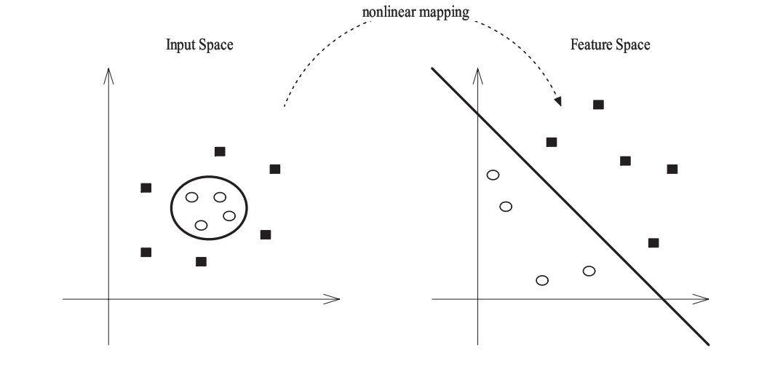
SVM kernels
Used non-linear SVM Classifier using the Rbf(Radial-basis function) kernel.
Mapping from input space to feature space to simplify classification task

Slide 5
Tools used
Matlab
  for implementing algorithms
  for extracting feature vectors
LibSVM and its Python bindings
  Training and generating SVM models
  Predicting the images based on labels

Slide 6
Research Approach
Studied the principles behind SVM and other machine learning algorithms
  http://www.stanford.edu/class/cs229/
  Support vector machines (Cristianini, taylor)
Consulted Inseong Kim , Stanford university , regarding her work on skin detection
Contacted Prof. Chiou-Shann Fuh, National Taiwan University, regarding his previous work on the field
Collected and studied related papers.

Slide 7
Dataset collection
Compaq Dataset used in “Statistical Color models with Application to Skin Detection” collected by contacting Michael Jones, MERL Research.
Images from the internet
Manual Labeling of the Images collected from the internet

Slide 8
Algorithms studied and Implemented
Skin based
  RGB, YUV, YCbCr skin detection model
  Statistical Color models(Histogram and GMM)
Non Skin based
  BIC(Boundary Interior/Exterior classifier) Dlog distance for nudity detection
  Edge and shape method using moments
  Mpeg-7 descriptors(Color Structure , Scalable Color Edge Histogram , Dominant Color Descriptors)

Slide 9

Statistical Color models: Histogram
Skin and Non-skin color probability distribution is evaluated using the skin and non skin histogram
Compaq skin and non-skin dataset used
Skin and non skin model to classify skin based on

Slide 10
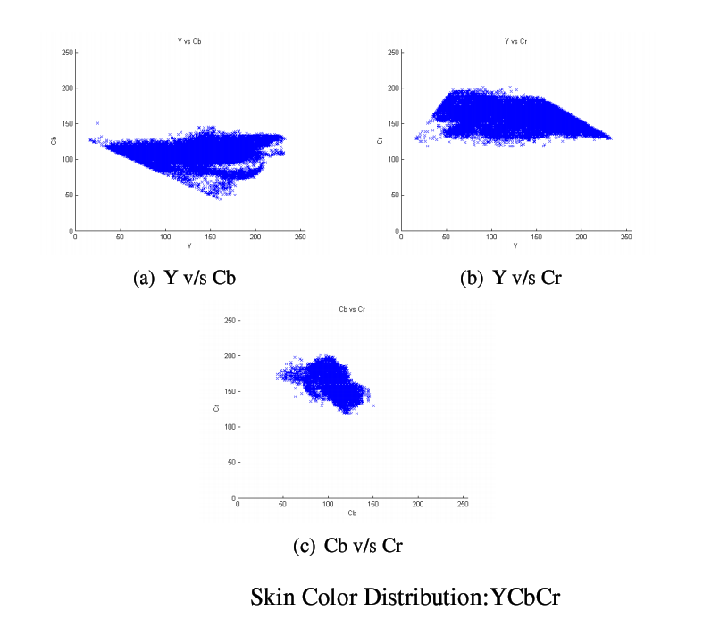
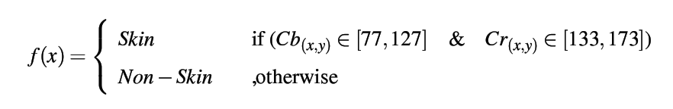
Skin color Distribution

Slide 11
Statistical Color models: Gaussian Mixture model
Gaussian Mixture model is a probabilistic model for density estimation.
Gaussian mixture model is used to construct multimodal density distribution.
Skin and Non-Skin color distribution model was created using GMM.

Slide 12

BIC(Border/Interior pixel Classification)
Pixels classified as Interior and Exterior
  Border pixels
    If four neighbouring pixels(top,bottom,left,right) has atleast one different quantized color.
  Interior pixel
    If four neighbouring pixels has same quantized color

Slide 13
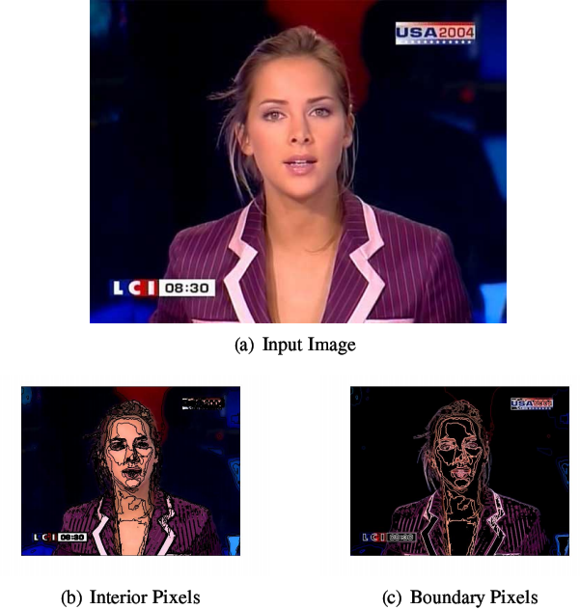
BIC

Slide 14
BIC Approach and SVM
Histogram of boundary/interior pixels
Logarithmic normalization of the histogram
Color quantized to four colors per channel (RGB)
Log scaled BIC histogram used as feature vector (feature vector size = 128)

Slide 15
Edge and Shape detection Method
Edge Map calculated using sobel filter
  From the edge map,a set of 28 feature vectors were extracted(21 normalized central moments upto order five and 7 Hu set of invariant moments)

Slide 16
Mpeg-7 Visual Descriptors
  MPEG-7 standard specifies a set of descriptors, each defining the syntax and the semantics of an elementary visual low-level feature.
Tried using 4 different visual descriptors based on colors and texture.
Dominant Color, Color Structure Descriptor
Scalable Color Descriptor mixed with Edge histogram descriptor

Slide 17
Dominant Color Descriptor
Clustering colors into a small number of representative colors
Generalized Lloyd algorithm is used for color clustering.
Consists of the Color Index(ci), Percentage (pi), Color Variance (vi) and Spatial Coherency (s); the last two parameters are optional.
Colors quantized into 18 colors

Slide 18
Scalable Color Descriptor
SCD is a color histogram in a uniformly quantized HSV color space
Encoded by Haar Transform
64-bins histogram used in the project quantised to a 11-bit value

Slide 19
Edge Histogram Descriptor
Represents the spatial distribution of five types of edges
  vertical, horizontal, 45°, 135°, and non-directional
Generating a 5-bin histogram for each block
It is scale invariant

Slide 20
Color Structure Descriptor
This descriptor expresses local color structure in an image using an 8 x 8-structuring element.
HMMD color space is used in this descriptor.
value in each bin represents the number of structuring elements in the image containing one or more pixels with color c_{m}

Slide 21
Mpge-7 and SVM
In DCD,feature vector consisted of 8 vectors i.e. top 4 color indices and their percentages respectively.
In SCD mixed with EHD,a total of 69 features (64 from SCD and 5 from EHD) were used.
In CSD, total of 64 feature vectors(color structure histogram) were calculated on the HMMD color space

Slide 22
Experimental Setup
Trainset Statistics
  No of adult imges = 942
  No of Non-adult images = 986
TestData Statistics
  No of samples = 452
Grid Search for optimal parameter estimation
RBF(radial basis function)

Slide 23
Experimental Results
Method | Training CV accuracy (per cent) | Test Accuracy (per cent)
BIC | 84.068 | 84.52
CSD | 83.428 | 80.142
DCD | 58.6283 | 70.354
SCD + EHD | 84.7922 | 78.3186
Moment | 71.586 | 61.3097

Slide 24
Future work
Weighted feature Vector SVM implementation for classification.
Study and implement recent development in machine vision technology.
Improve time complexity of the implemented algorithims.

Slide 25
Research paper studied
Jones, M. J. and Rehg, J. M. 2002. Statistical color models with application to skin detection. Int. J. Comput. Vision 46, 1 (Jan. 2002), 81-96.DOI= http://dx.doi.org/10.1023/A:1013200319198
Margaret M. Fleck, David A. Forsyth, and Chris Bregler. Finding naked people. In ECCV (2), pages 593–602, 1996
James Z. Wang, Gio Wiederhold, and Oscar Firschein. System for screening objectionable images using daubechies’ wavelets and color histograms. In IDMS ’97: Proceedings of the 4th International Workshop on Interactive Distributed Multimedia Systems and Telecommunication Services, pages 20–30, London, UK, 1997.Springer-Verlag
R. O. Stehling, M. A. Nascimento, and A. X. Falcao. A compact and efﬁcient image retrieval approach based on border/interior pixel classiﬁcation. In Proceedings of the
eleventh international conference on Information and knowledge management, pages 102–109. ACM Press, 2002.
Skin segmentation using color pixel classiﬁcation: analysis and comparison
Belem, R. J., Cavalcanti, J. M., de Moura, E. S., and Nascimento, M. A. 2005. SNIF: A Simple Nude Image Finder. In Proceedings of the Third Latin American Web Congress (October 31 - November 02, 2005). LA-WEB. IEEE Computer Society, Washington, DC, 252. DOI= http://dx.doi.org/10.1109/LAWEB.2005.32

Slide 26
Research paper studied
  L. Duan, G. Cui, W. Gao, H. Zhang, “Adult image detection method based-on skin colour model and support vector machine”
  Evaggelos Spyrou, Hervé Le Borgne, Theofilos Mailis, Eddie Cooke,Yannis Avrithis, and Noel O’connor. Fusing mpeg-7 visual descriptors for image classification. pages 847–852. 2005.
Ahmed Ibrahim, Ala'a Al-Zou'bi, Raed Sahawneh and Maria Makhadmeh ,Fixed Representative Colors Feature Extraction Algorithm for Moving Picture Experts Group-7 Dominant Color Descriptor
  C.-C. Chang and C.-J. Lin. LIBSVM: a library for support vector machines, 2001. Software disponvel em http://www.csie.ntu.edu.tw/~cjlin/libsvm/ .
M. K. Hu, "Visual Pattern Recognition by Moment Invariants", IRE Trans. Info. Theory, vol. IT-8, pp.179–187, 1962

Slide 27
Thank You!!!

